Slide 1


Chelsea F.C Branding Insight
Design document for Chelsea F.C Data Vizathon 2025
Jeffrey Jose

Slide 2
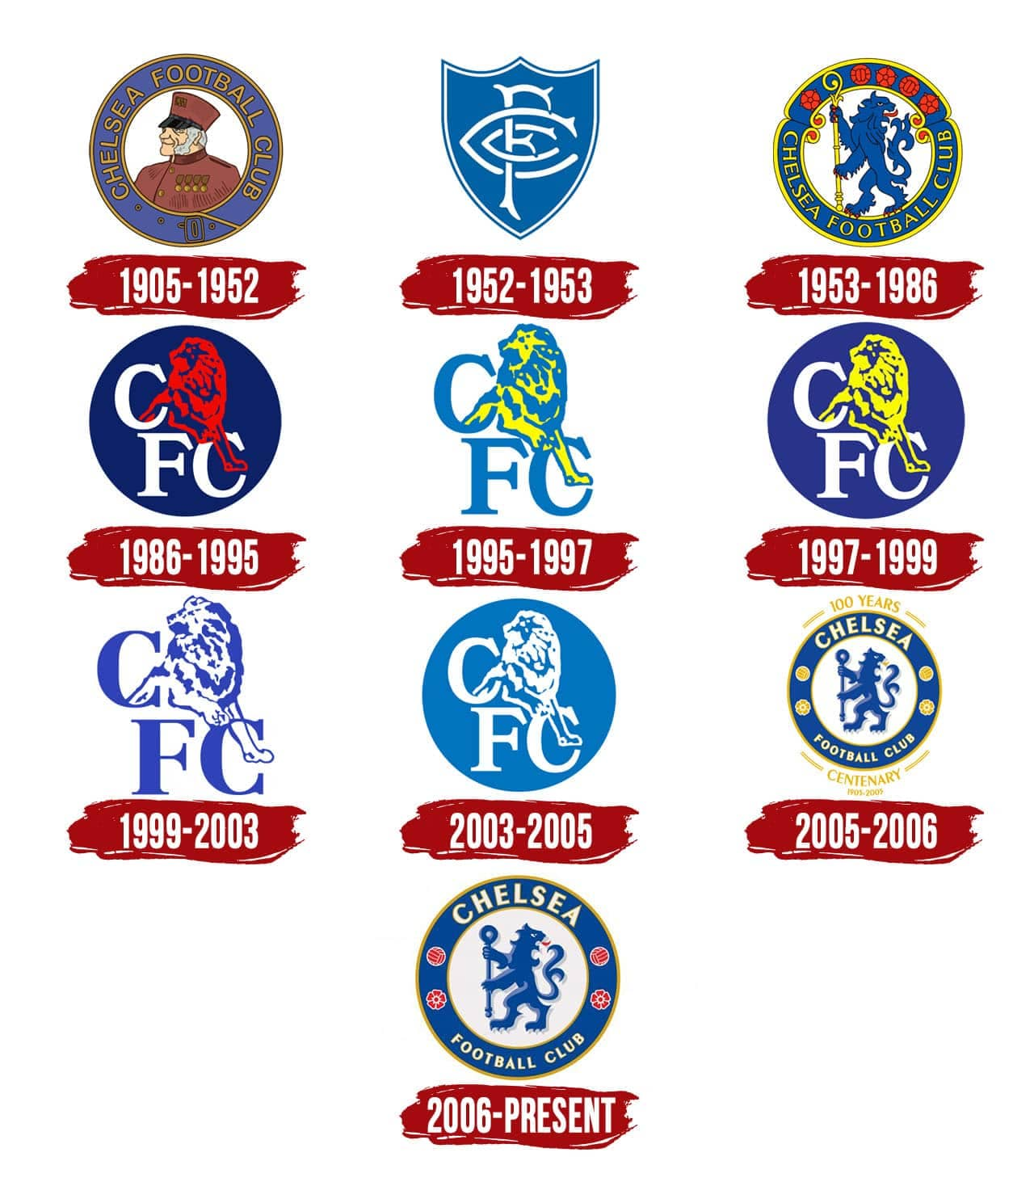



Logo

Slide 3
Brand Colours
Name: Midnight Blue Hex: #034695 RGB: (3, 70, 148) CMYK: (98, 53, 0, 42)
Name: Pigment Red Hex: #ED1C24 RGB: (237, 28, 36) CMYK: (0, 88, 85, 7)
Name: Gambage Hex: #DBA111 RGB: (219, 161, 17) CMYK: (0, 27, 92, 14)
Name: Light Blue Hex: #6A7AB5 RGB: (106, 122, 181) CMYK: (64, 51, 4, 0)
Name: Light Gray Hex: #D1D3D4 RGB: (209, 211, 212) CMYK: (1, 0, 0, 17)
Name: White Hex: #FFFFFF RGB: (255, 255, 255) CMYK: (0, 0, 0, 0)

Slide 5


Health Synchronization Engine
A player workload monitoring system
The Chelsea FC Player Workload & Physical Capability Dashboard provides a comprehensive overview of player performance, tracking key metrics such as speed, heart rate, and distance using GPS data. It highlights priority work areas, monitors recovery trends, and evaluates physical capability through strength, agility, sprinting, and jumping assessments categorized by movement quality and force expression (Isometric/Dynamic). This data-driven approach enables the coaching staff to optimize training, prevent injuries, and enhance player performance throughout the season.
@EdgeOfTheField
@Jeffreyjose29

Slide 6
GPS Recording
Distance
Speed
Heart Rate

Slide 7
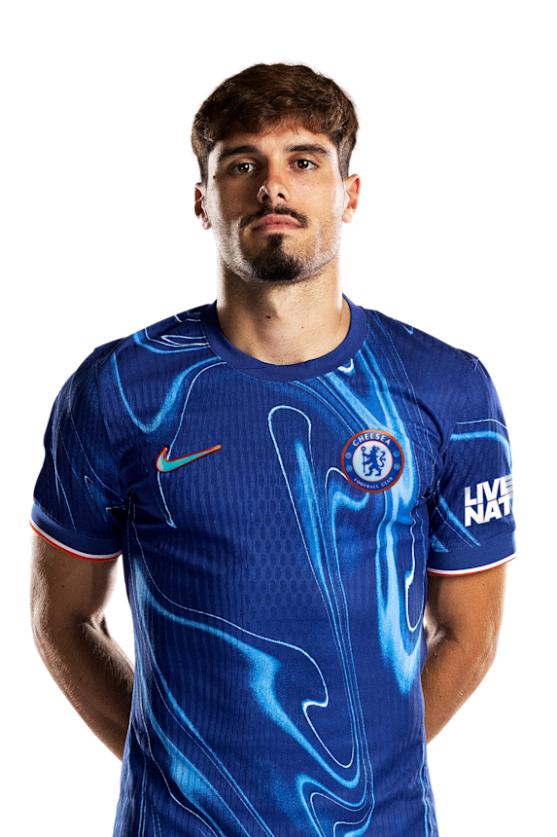
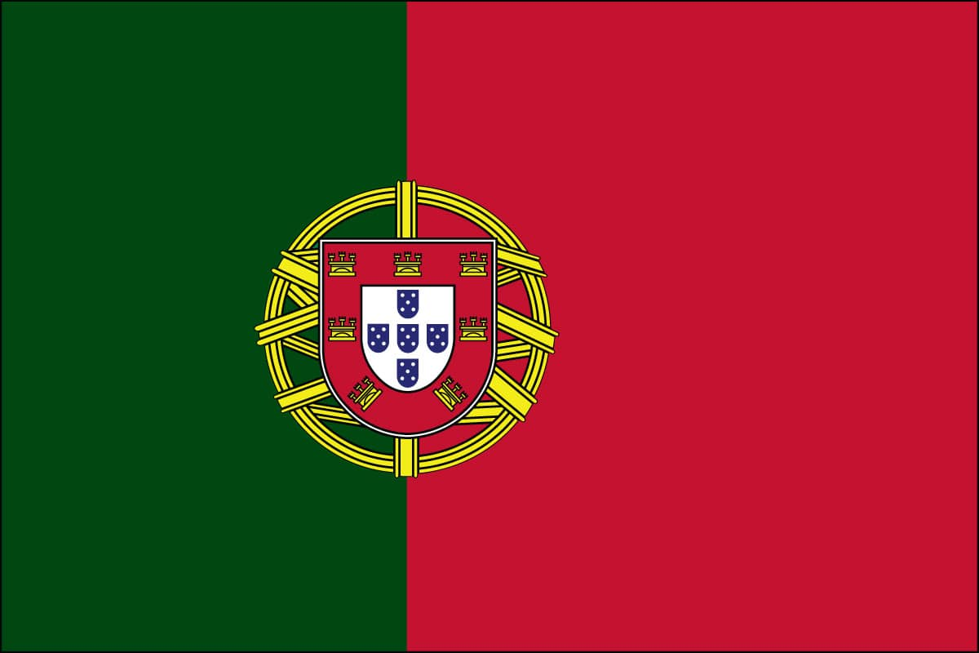

Pedro
7
NETO
NAME:
NATIONAL TEAM:
PLACE OF BIRTH:
POSITION:
PREFERRED FOOT:
DOB:
HEIGHT:
DEBUT:
MARKET VALUE:
Pedro Neto
Portugal
Viana do Castelo, Portugal
Winger
Left
9 March, 2000 (age 25)
1.74m (5ft 9in)
18 August, 2024
€50.0M

Slide 12
Priority Areas Monitoring

Slide 13
Physical Capabilities

Slide 14
Data Export

Slide 15
Player Recovery

Slide 16
The Player Health Synchronization Engine
Submission For The Chelsea FC Data Vizathon
@EdgeOfTheField
@Jeffreyjose29

